Slide 1
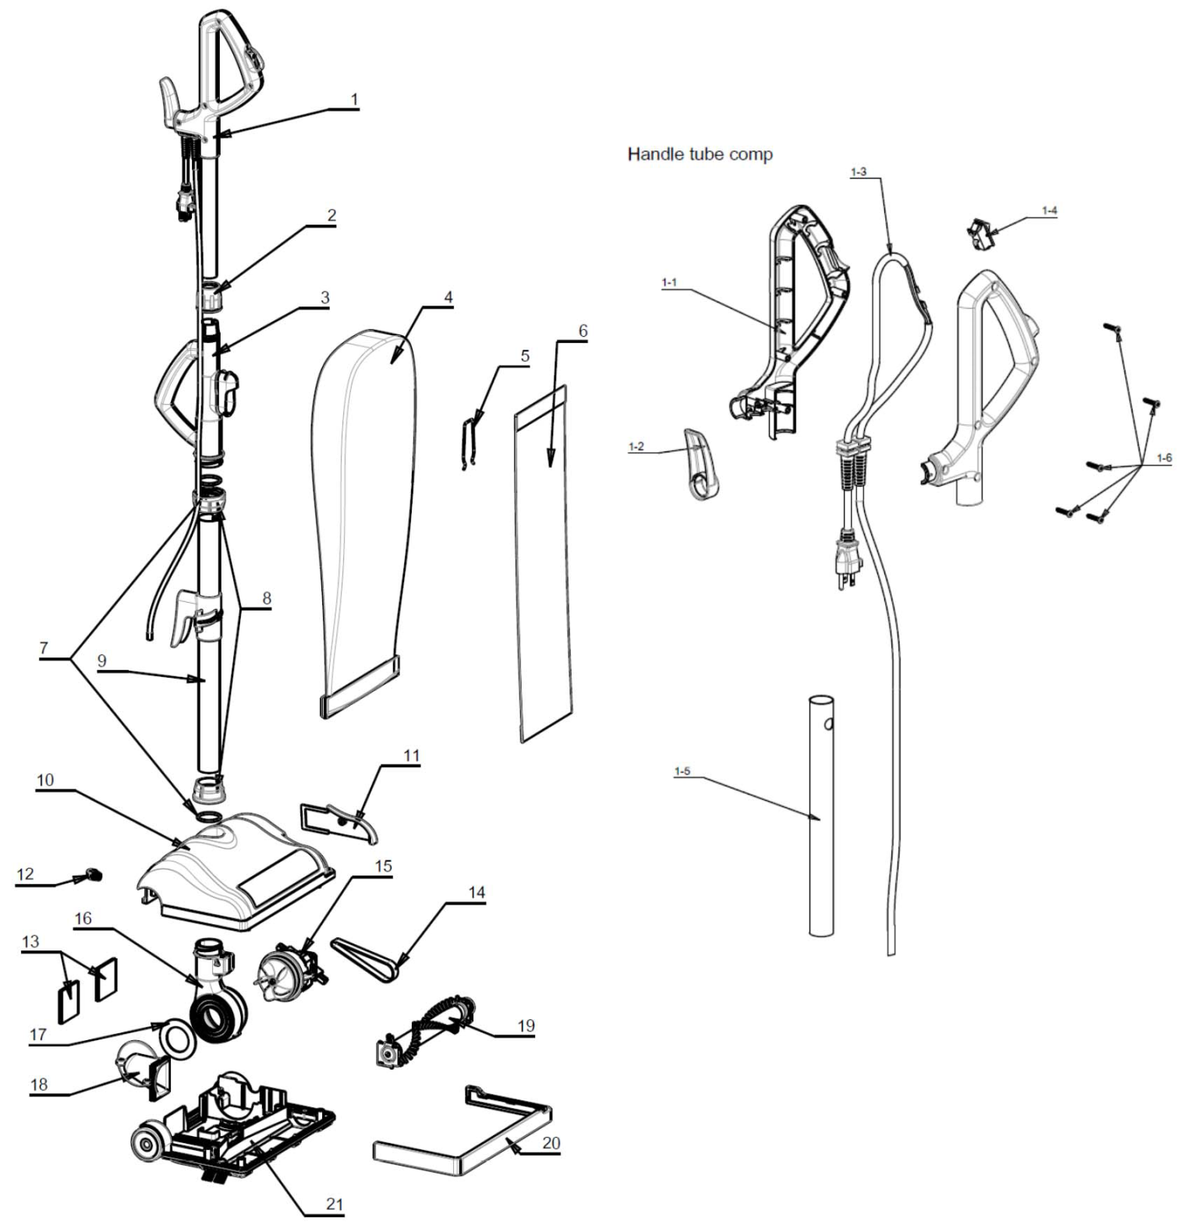
Clean Obsessed
CO202 Parts Schematic Page 1 of 3
Items that do “not” begin with 202xx, are probably not in our syatem!

Slide 2
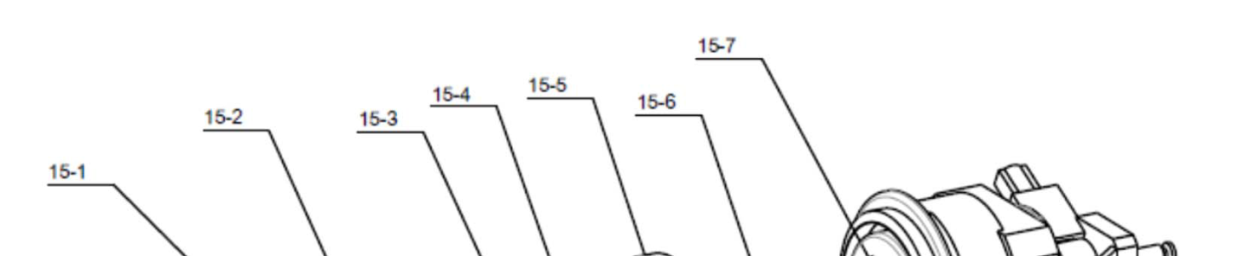
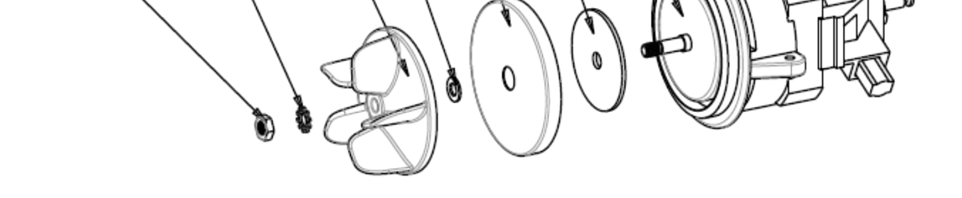
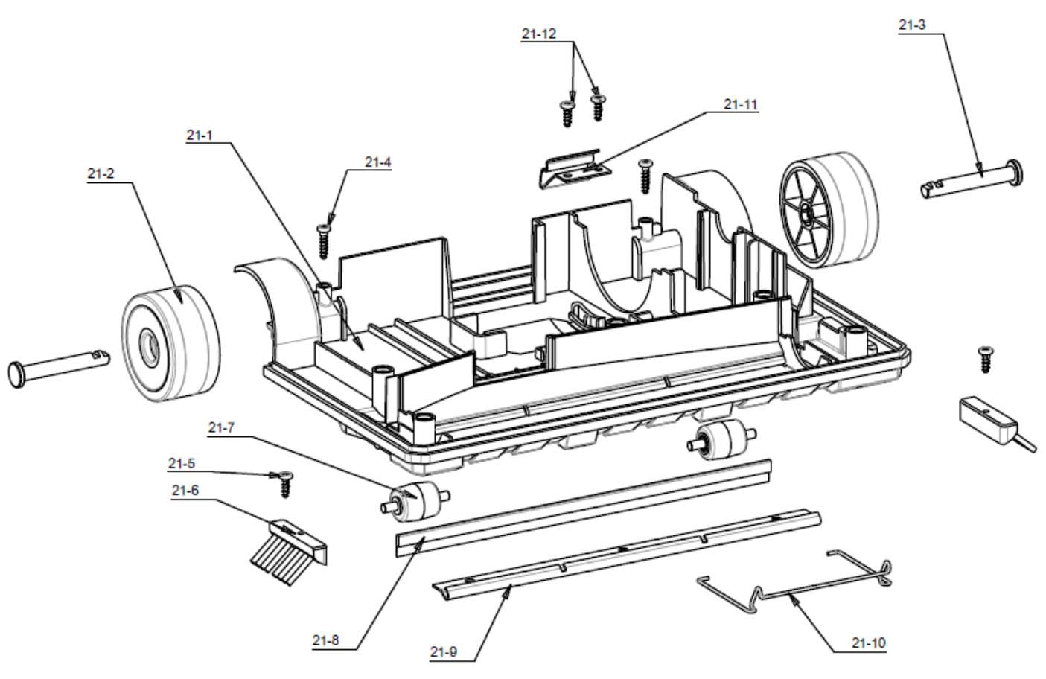
Clean Obsessed
CO202 Parts Schematic Page 2 of 3

Slide 3
Clean Obsessed
CO202 Parts Schematic Page 3 of 3
Diagram
Key # Item Number Description
1 20260 Handle Tube / Grip Assembly Complete w/Handle Cord
1‐1 U8000‐1‐1 Top Handle Grip‐R
1‐2 20289 Upper Cord Hook
1-3 20290 Power Cord Pigtail, 84”
1‐4 20291 ON/OFF switch
1‐5 U8000‐1‐5 Upper Tube
1‐6 U8000‐1‐6 Handle Screws
2 20261 Upper Handle Retaining Collar
3 20262 Center Carry Handle
4 20263 Outer Cloth Bag
4A U8000‐4‐1 Outer Bag Bottom Clip
5 U8000‐5 Bag Retaining Clip
6 CO202BG H-10 HEPA Bags, 9/Pkg
7 20264 Handle O-Ring (Upper & Lower the Same)
8 20266 Lower Handle Retaining Collar
9 20267 Lower Handle Tube Assembly w/Lower Cord Retainer
10 20268 Hood Assembly
11 20269 Belt Cover
12 U8000‐12 Strain Relief Bushing
13 20271 Exhaust Foam Filter
14 20272 Belt
15 20295 Motor Assembly
15‐1 U8000‐15‐1 Motor Nut
15‐2 U8000‐15‐2 External Tooth Washer
15‐3 20294 Fan
15‐4 U8000‐15‐4 Washer
15‐5 U8000‐15‐5 Motor Cover
15‐6 U8000‐15‐6 Motor Gasket
15‐7 U8000‐15‐7 Motor
16 20273 Fan Housing / Air Duct / Swivel
17 20274 Inlet Duct Gasket
18 20275 Inlet Duct
19 OR201 Brush Roller
20 20276 Furniture Guard / Bumper
21 20277 Base Plate Complete w/wheels (No Bumper)
21‐1 U8000‐21‐1 Base Plate
21‐2 U8000‐21‐2 Rear Wheel with Oil Bearing
21‐3 U8000‐21‐3 Rear Wheel Shaft
21‐4 U8000‐21‐4 Ear Wheel Shaft Locking Screw
21‐5 U8000‐21‐5 Side Brush Screw
21‐6 20281 Side Brush, Sold Ea.
21‐7 20282 Front Roller with Shaft
21‐8 20283 Rubber Blade
21‐9 20284 Bottom Metal Plate
21‐10 U8000‐21‐10 Support Frame
21‐11 U8000‐21‐11 Shrapnel
21‐12 U8000‐21‐12 Shrapnel screw
Not Shown CD7212Y Extension Cord, 50’ 3-Wire, Yellow, 300v
Has LED Female Plug

